Slide 1
2025 Troop Cookie Manager Training
Cookie Program Overview
Notes:
Hello and welcome to the 2025 Troop Cookie Manager Training

Slide 2
Online Training Series
Five Training Videos
Cookie Program Overview
Engaging Families and Girl Scouts
Managing the Cookies
Managing the Cookie Finances
Smart Cookies and Digital Cookies
Notes:
This the first of a series of five training videos and will serve as an overview of the 2025 Cookie Program.

Slide 3

Section Topics
Troop Cookie Manager Role Checklist
2025 Program Updates
Key dates for 2025
Online and Print Resources
Cookie Business Family Meeting
Your Cookie Support System
Notes:
In this overview we'll cover:
The TCM Role checklist
The Program Updates for 2025 and
Key dates you’ll need to know
We’ll go over your responsibilities as Troop Cookie Manager
We’ll discuss the importance of holding a Cookie Business Family Meeting
We’ll take a look at some of the Online and Print Resources
And last, we’ll go over Your Cookie Support System

Slide 4
Troop Cookie Manager Role Checklist
Complete training
Complete the online Troop Cookie Responsibility Form by February 1
Host a Family Cookie Business Meeting
Help troop & Girl Scouts set their goals
Manage cookie inventory
Manage Smart Cookies and Digital Cookie
Distribute rewards
Notes:
We are so grateful for you as you share your time and talents to the Cookie Program. It’s your dedication that makes the cookie season possible and helps Girl Scouts develop leadership skills and powers your troop’s adventures. Let’s take a moment for a quick overview of the tasks that are part of your role as a Troop Cookie Manager:
-You’re currently working on the first step, to complete training.
-All troop leaders and cookie managers should complete the online troop cookie responsibility form by February 1
-Host a cookie business family meeting, more on this shortly
-During this meeting, or at another time, distribute your troops print materials to the Girl Scouts in your troop
-Help your troop and individual Girl Scouts set their cookie goals
-Manage cookie inventory
-Manage Smart Cookies and Digital Cookie – our online cookie systems
-and last but not least, distribute reward to your Girl Scouts after the sale

Slide 5


2025 Program Updates for Girl Scouts
New Mascot & Theme
New Cookie Proceeds for Troops & Communities
  $1 per package
    All cookies are $6 per package
  Opt-out option continues for Senior/Ambassador Troops
Final Year for the Toast-YAY!
  Commemorative patch initial order reward
Notes:
Let’s dive into what’s NEW for the 2025 Cookie Program! We’ve got some exciting updates to share, so let’s break it down:
First up, a brand-new mascot and theme! The face of the program is Noodles the Panda with the theme of Embrace Possibilities—it’s going to be a hit with the girls.
New cookie proceeds are coming for troops. All Troops earn $1/pkg. All cookies are still $6 per package. We still offer the opt-out option for Senior/Ambassador Troops to earn an additional .05/pkg.
And now, for some bittersweet news—it’s the final year for the Toast-YAY! That’s right, this cookie is heading into retirement. But don’t worry, we’re sending it off in style with a commemorative patch as an initial order reward if troops follow the Cookie Calculator recommendation. This does mean we’ll have a new cookie in 2026!

Slide 6

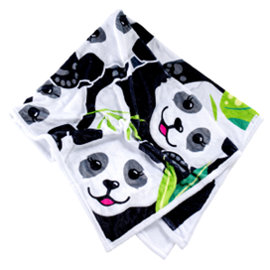

2025 Program Updates
Cookie Rewards
  Cookie Credits begin at 60 packages
  Valleyfair Event on June 22, 2025
  Troop Per Girl Average (PGA) Rewards
  Disney Travel Reward at 5000 packages, June 11-14
  New LemonAID Philanthropic Partner: Pet Haven of MN
Notes:
Let’s talk about the updates to our cookie rewards this season:
Cookie Credits start at just 60 packages! That’s a change based on feedback from our volunteers.
We are introducing our first-ever Girl Scout Cookie Sellers Day at Valleyfair on June 22. All troops will be invited to attend with special discounted pricing on tickets. We even have a way for troops to earn free admission to the event.
We’ve updated our Troop Per Girl Average rewards: We have new items like this popular panda neck pillow at the 300 PGA level, the panda blanket that is SUPER plush and available at the 400 PGA level, and finally, if a troop achieves a 500 PGA, they’ll have the choice to either receive a $25 membership credit for each girl selling and 2 adults or free admission to the Valleyfair event on June 22.
For the go-getters, there’s the Disney Travel Reward for 5,000 packages. We’ll provide more details in our Rewards Fine Print on Cookie Central, but the cliff’s notes version is the trip is June 11-14, this is non-cumulative, which means girls would opt out of rewards at the 850-2000 level to instead take the trip. Girls who select the trip will be able to attend Dream Team and receive the top seller package at the 3000 package level. For the trip, Transportation is not included, but the accommodations, park passes, and a dining plan is all included in the trip.
And last, our new LemonAID philanthropic partner is Pet Haven of MN. It’s a pawsome cause that Girl Scouts can feel good about supporting with their efforts. Any girl that chooses to support the LemonAID program instead of receiving a reward at the 130 package level will receive a special patch. Learn more about this great organization at pethavenmn.org.

Slide 7


2025 Program Updates
Volunteer Communications
Rallyhood
  Council Wide Troop Product Program Volunteers
  Cookie Swap Rallies
    9 new rallies based on geographic areas
Just-in-time Resources
  The Cookie Press
  Direct-to-Volunteer Emails
Notes:
Our goal is clear and consistent communication with our troop-level volunteers to keep you up to date on the program all season long. New for 2025, we have created a Rally in Rallyhood exclusively for troops. It’s the
-Council Wide Troop Product Program Volunteers – GSRV Rally. You’ll receive an invitation to join the rally in your email. Any information shared in Rallyhood will also be added to the Girl Scouts River Valleys Troop Product Program Volunteers page on Facebook.
Speaking of Rallyhood, we’ve also transitioned our Cookie Swap to Rallyhood,. The Cookie Swaps are where you can connect with troops outside of your community to arrange for cookie transfers. We’ll have a variety of Cookie Swap rallies available for you to join based on the Area of our Council that you live in. You can join one, or as many Rallies as you like. We’ll share direct links to these rallies in The Cookie Press when the season begins.
-And just-in-time resources will be used throughout the program to ensure you have what you need to successfully assist the Girl Scouts in your troop. This includes The Cookie Press and other direct-to-volunteer emails.

Slide 8
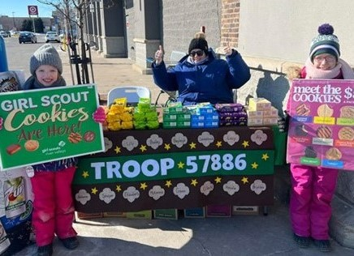
2025 Program Updates
Cookie Booths
Cookie Booth Guide & Booth Kit
Updated: Cookie Booth Do Not Contact List
New List: Businesses Available for Troop-Secured Booths
  Note: GNC & Dunkin Donuts now available for troops to contact
Notes:
Don’t forget to check out the cookie booth resources available on Cookie Central, which includes our updated Cookie Booth Guide. You will receive the cookie booth guide in your print materials as well. This guide walks you through cookie booth basics, taking customer payments, additional selling tools, and more!
We’ve also updated our Do Not Contact list, which lists the businesses that either are working directly with River Valleys on council-secured booths or have declined to participate in booths. New this season is a list of cookie booths that will no longer be secured by River Valleys starting this cookie season. What does this mean? You can use this Business Available for Troop-Secured Booths list to reach out to the individual stores for troop-secured booths. An example of two former council-secured booth locations that can now be troop-secured include all Dunkin Donuts and GNC stores. The Do Not Contact list and Newly Available will be updated on Cookie Central soon and we’ll share the link in The Cookie Press as well.

Slide 9
2025 Program Updates
Cookie Exchange & New Resources
Cookie Exchange Opportunities
Timeframe in progress, to be announced in The Cookie Press
Full, bakery-sealed cases
Caramel Chocolate Chip not exchangeable
Cupboard staff will be inspecting all exchanges
New Resource for First-Year Troops
Easy-Baked Cookie Program
  Designed to guide new troops on participation options
Notes:
We are wrapping up with two more updates—Cookie Exchange Opportunities and a new resource for first-year troops!
First, Cookie Exchange Opportunities:
Keep an eye on The Cookie Press for the timeframe announcement. We’re still working on the dates and the details for the exchanges. This will NOT happen within the first two weeks. Exchanges will be limited to full, bakery-sealed cases, so plan accordingly. And just a heads-up—Caramel Chocolate Chip cookies are not eligible for exchanges. We hope knowing exchanges will be available will help to feel confident in placing an initial cookie order. All exchanges will be inspected by the cupboard staff before accepting the exchange. Any cases that are NOT sealed or have missing or other cookie packages inside will be turned away. River Valleys will also consider ending exchanges should we see frequent exchanges that are not following these guidelines.
Now, for our new resource:
We’re introducing the Easy-Baked Cookie Program for first-year troops. This is designed to help new leaders navigate the cookie season with a menu of options that they can select from based on their comfort-level and time available. Our hope is that our newest troops can build a foundation with the basic elements of the sale, then continue to build on that foundation as they and their Girl Scouts progress with the Cookie Program. This resource will be emailed to new troops and posted on girlscoutsrv.org.

Slide 10
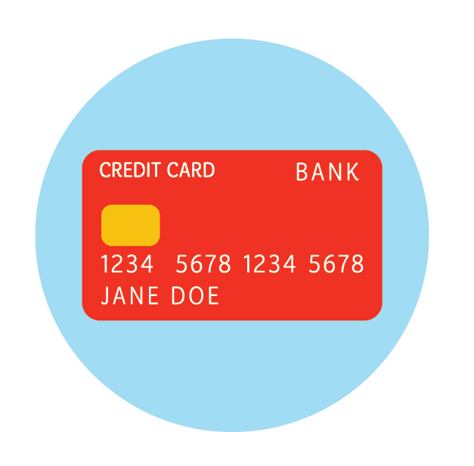

Popular features return!
River Valleys will cover 100% of the transaction fees for troops using Digital Cookie to process credit card/Venmo/PayPal payments
Digital Cookie Shipping Promotions
  Minimum order of 4 packages
  Shipping rates on Cookie Central
Notes:
While we have those new or updated elements, we have popular features that are returning...
-River Valleys will cover 100% of the transaction fees for troops using Digital Cookie to process credit card/Venmo/PayPal payments
-Troops and Girl scouts will be able to share links for shipped cookie sales again this season. To help make it a sweeter deal for those interested customers, we will once again have a shipping promotion during the season. We are still working on the details and once it is finalized, we’ll share it in The Cookie Press. As a reminder, there is a minimum required order of 4 packages of cookies for all shipped cookie orders. Customers will receive email updates, including tracking information, to keep them informed until their order arrives. Make sure to share the promotion details with your troop so they can promote it with their families.

Slide 11

Key Dates for 2025 Cookie Program
January 24 | Troop Initial Order Deadline
February 12 | Online & Pre-sales Begin
February 21 | Cookie & Booth Go Day
March 30 | Cookie Program Ends
April 6 | Troop Reward Deadline
Week of May 19 | Rewards Ship to Communities
Notes:
Here’s a quick glance at the key cookie dates for the season, which are all included in the Troop Cookie Companion which you’ll receive from your Community Product Leader. This resource, and the Troop Guide, can also be found on Cookie Central.
If your troop would like cookie inventory on hand for Go Day (the first day of cookie sales), you will need to place an initial order in Smart Cookies by Jan. 24.
Online & Pre-sales (when Girl Scouts can begin to take orders on their order cards) is Feb. 12
Cookie and Booth Go Day is Feb 21
The cookie season wraps up on Mar 30
The deadline for entering you your troop’s cookie rewards into Smart Cookies is Apr. 6
Rewards will ship to communities the week of May 19 – your CPL will reach out to you to distribute your troop’s rewards for you to hand out to your troop.

Slide 12

Cookie Resources:
Community Product Leader
Girl Scouts River Valleys Staff
  girlscouts@girlscoutsrv.org
  800-845-0787
Smart Cookies & Digital Cookie
Online & print resources
Notes:
Your Community Product Leader and our team are here to guide you throughout the cookie season. We’ll be there to give you a high-five when you share your successes and offer support when you need it. The Community Product Leader is available to give you that local support from distributing materials, sharing community-specific information, to facilitating cookie transfers, and much more. Girl Scouts River Valleys staff is also here to help by email or by phone. To manage the cookie sale online, you’ll use Smart Cookies and Digital Cookie, which will cover in more detail later in our training series. And now, we’ll cover the many online and print resources we’ve developed to support you in your role.

Slide 13
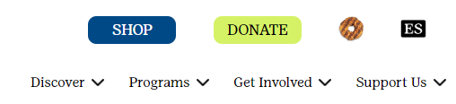


Online Resources:
Cookie Central (GirlScoutsRV.org)
The Cookie Press
Cookie Guidebook for Troops
Online Cookie Systems Guide
Digital Cookie Help Center for Girl Scouts & Families
Cookie Cupboard Information
Notes:
Let’s start with Cookie Central. It’s the most popular page on Girl Scouts RV dot org with our one-stop shop for cookie resources for your troop role and for your troop families. From our homepage, click on the Caramel deLite in the upper right-hand corner to access our Cookies page, from there you can access Cookie Central. You can also use the QR codes in your print materials to be directed to the site. Make sure to bookmark or favorite Cookie Central for easy access.
Cookie Central also features quick links to The Cookie Press E-newsletter which will be emailed to you each Thursday. If you haven't received the Cookie Press, please contact us to troubleshoot the issue. Along with the Cookie Press, Cookie Central also has links to the Troop Cookie Guidebook, our Online Cookie Systems Guide for troops & the Digital Cookie Help Center for families, cookie cupboard information, plus a whole lot more!

Slide 14

Print Resources:
Ship the week of December 30 to your Community Product Leader
Items that your troop will receive:
  Troop Cookie Companion
  Cookie Booth Kit
  Receipt Books
  1 Sample Package of Cookies per troop
  Family Guides
  Order Cards
  Reward Flyer
  Money Envelopes
Notes:
The supply of print materials for Troops & Girl Scouts will ship the week of December 30 to your Community Product Leader. They will connect with you to pick-up these items after they've sorted and prepared them for your troop. The print materials that each troop will receive include: the Troop Cookie Companion, Cookie Booth Kit, Receipt Books, a sample package of Toast-Yay’s, Family Guides, Order Cards, Reward Flyers, and Money Envelopes for each Girl Scout in your troop. If you need additional supplies, connect with your Community Product Leader.

Slide 15

Cookie Business Family Meeting
Check out the online Cookie Business Family Meeting resources on Cookie Central
Set a time/date and invite families (virtual or in-person)
Meeting topics
  Ways to sell cookies
  Cookie Goals
  Volunteer Opportunities
  Cookie Rally information
  Troop Cookie Calendar
  Cookie Materials
Notes:
Holding the Cookie Business Family meeting is an important part of your role. It’s a time to connect with the Girl Scouts and caregivers in your troop to discuss plans for the season, along with expectations and responsibilities. You can view our resources on Cookie Central to help you in planning and holding this meeting, including a meeting tip sheet and a presentation to help guide the meeting. Let's review the things you should be sure to talk about:
-First and foremost, be sure that families complete the Family Cookie Responsibility Form, available on Cookie Central. This form must be on file before families receive inventory. This will be required if a troop needs to complete a Finance Inventory Issue Form at the end of the season. We’ll discuss this form later in the Managing Cookie Finances training.
-Share the Ways to Sell Cookies.
-Discuss the Troop's Cookie Goals, does the Troop want to go to camp? Travel? Do a community service project?
-Discuss other ways that families can support their Girl Scout and the Troop. There are so many opportunities to get caregivers involved, such as helping with cookie booths, picking up additional inventory at cookie cupboards, brainstorming creative ways to sell or creative marketing opportunities or images, or even picking up the troop’s initial cookie order and helping to sort & distribute cookies. Enlisting their help will help to keep the sale manageable for you and the troop leader.
-Let them know if your community is hosting a Cookie Rally, if not, don't worry River Valleys will be hosting a free, virtual rally on February 4! Look for more information to come in the Cookie Press.
-Set your Troop Cookie Calendar, beyond setting a Troop Cookie Return date so you can manage the inventory, this calendar sets the expectations for your time and availability, you can let families know the schedule for ordering/picking up more cookies from you, your communication style and expectations on response times.
-Last, be sure to distribute the Family Cookie Materials (which you received from your Community Product Leader)

Slide 16
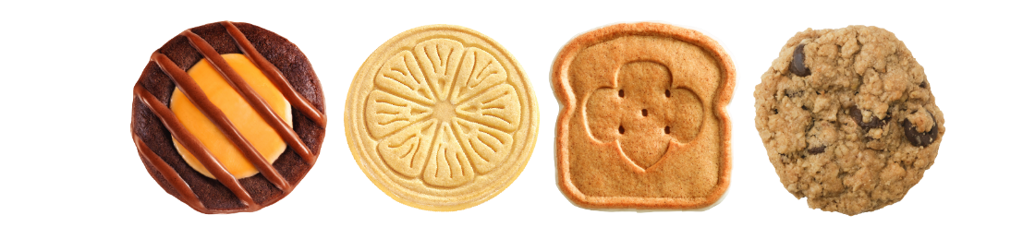
Setting Goals
Troop goals
  Camp, travel, community service project
Individual Girl Scout goals
  Rewards
Plans to achieve the goals
Inform parents/guardians
Report on the progress during the sale
Notes:
Goal setting is one of the five skills that girls learn from participating in cookies, and it’s also part of your role as you lead the troop in developing goals, both for families and the troop as a whole. Invite the troop to brainstorm what they want to do with their cookie proceeds, what would it cost? Camp, travel, a community service project, or a fun adventure are a few ideas to start. How many cookies will they need to sell to make it happen? Once they’ve settled on a goal, discuss what they need to do to reach it. Discuss individual goals with each member of the troop. Do they feel it’s achievable? How do they plan to reach it? Did they participate last year? Share sales information from last season. Are they motivated to achieve a certain reward level and what plans do they have to achieve it? Make sure the families are aware of and agree to the individual goals. And don’t forget to update on their progress as the sale progresses.

Slide 17



Your Cookie Support System: We got you!
GIVE US A CALL
800-845-0787
Phone line hours: M-F, 9 AM-5 PM
SEND US AN EMAIL
girlscouts@girlscoutsrv.org
PEER-TO-PEER SUPPORT
Council Wide Troop Product Program Volunteers - GSRV Rally
FIND US ONLINE
Cookie Central
The Cookie Press e-newsletter
Rallyhood
Notes:
We can’t emphasize this enough…..anytime you need support, reach out! There’s lots of options to get the answers and support you need. You can:
Connect with your Community Product Leader or reach out to River Valleys Staff:
Give us a call
Send us an email
Find us online – with The Cookie Press newsletter, join our Troop Product Program Managers Rally in Rallyhood, and of course, on Cookie Central! We are all in together to help our Girl Scouts have the best cookie season possible.

Slide 18
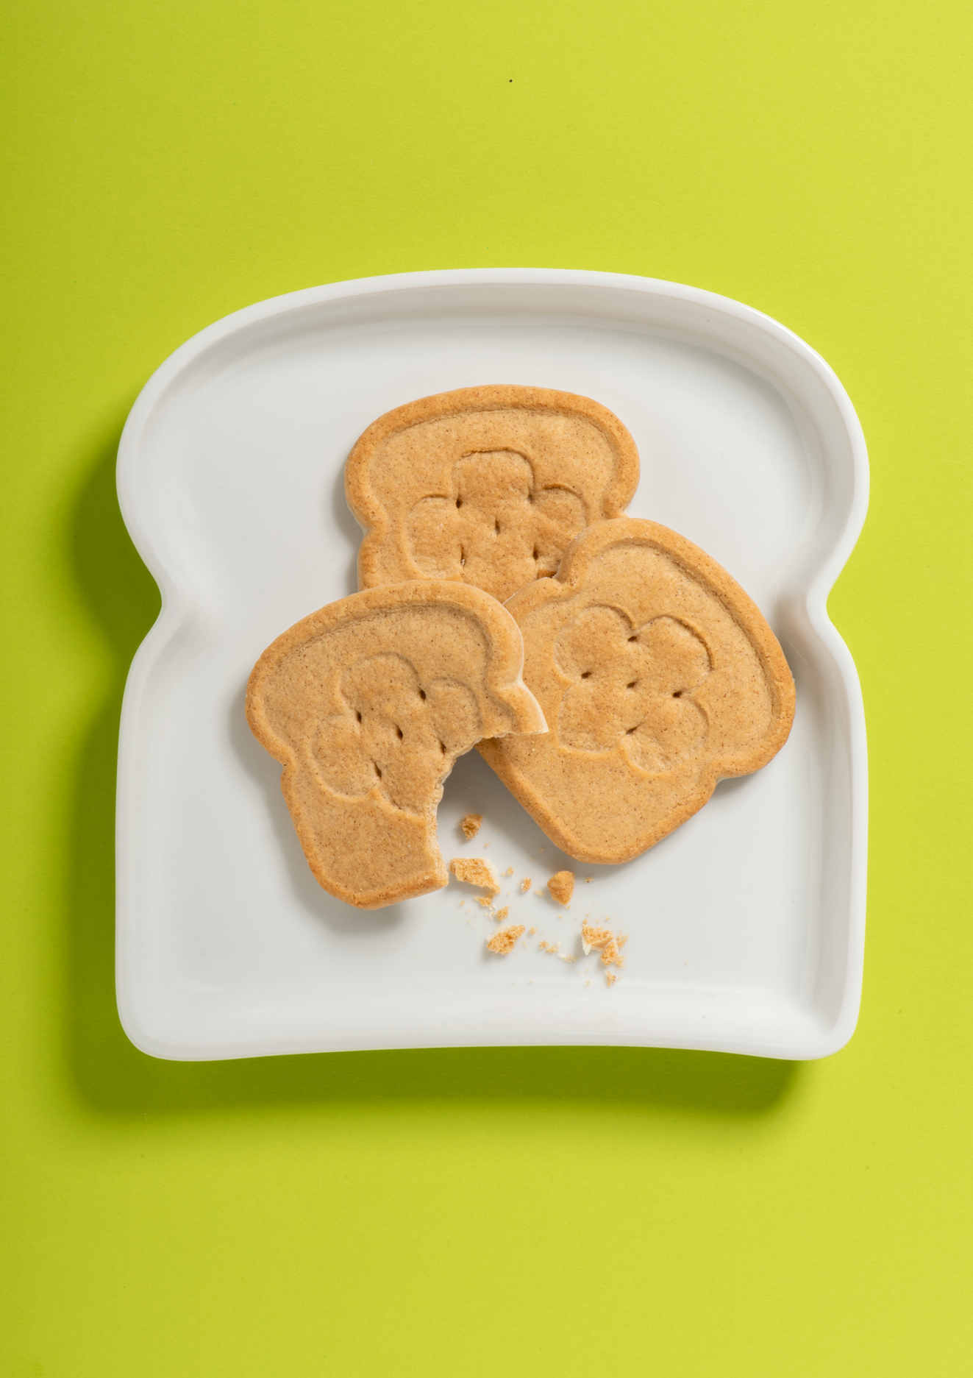
Key Takeaways
Troop cookie managers have an important role to support Girl Scouts and their families
New program elements for 2025
Key Dates
Your cookie support system & resources
Notes:
Here are the key takeaways from our Program Overview topics:
Troop cookie managers have an important role and complete essential tasks to support Girl Scouts and their families during the season
We overed the new program elements for 2025
As well as the Key Dates for the season
Your cookie support system & resources to assist you in your role.

Slide 19
THANK YOU!
Next Up: Engaging Girl Scouts and Families
Notes:
Thank you for joining us the program overview, next up, you’ll learn about Engaging Girl Scouts and Families in the cookie sale.

